Slide 1



AutoSense
Analytics
A data collection company utilizing vehicle mounted sensors

Slide 2
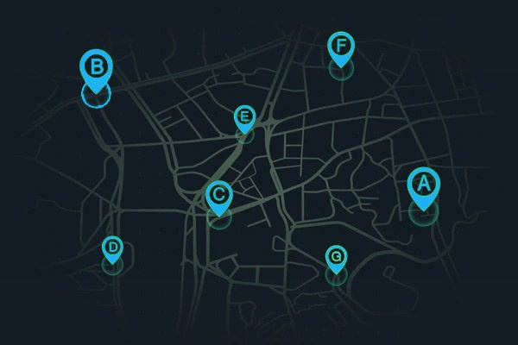
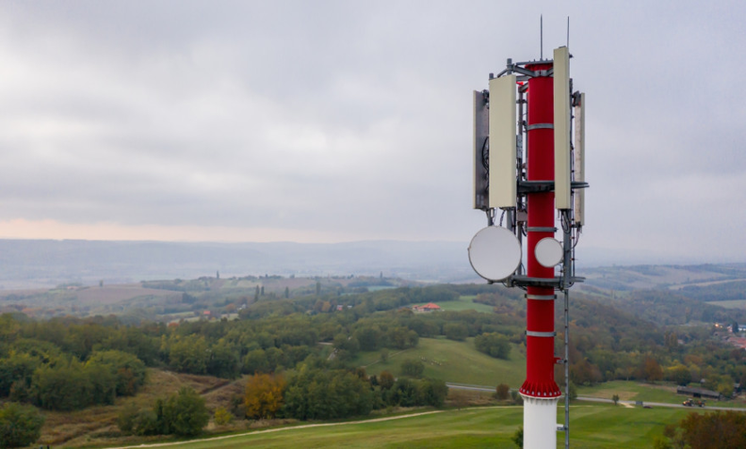
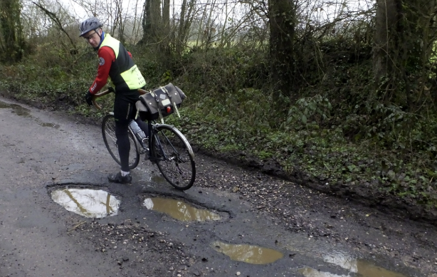
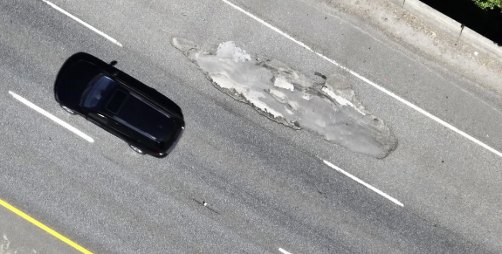
PROBLEM
STATEMENT
1
Lack of available data for Urban Infrastructure, needed for deployment and maintenance decisions
2
Network blind spots, weak signal strength, incorrectly positioned antennas
3
Not enough data for road quality and roughness, unsafe roads in need of maintenance

Slide 3
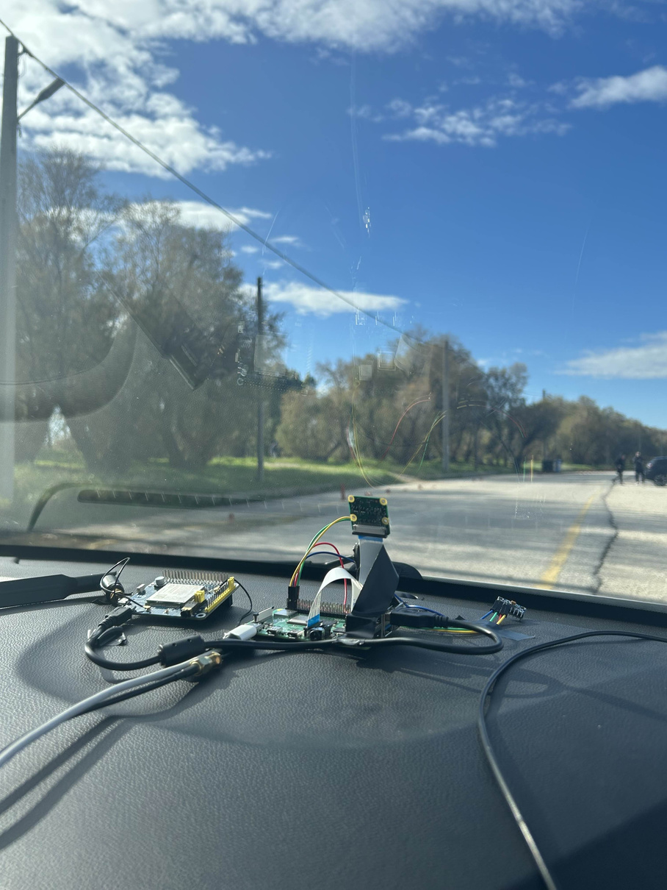

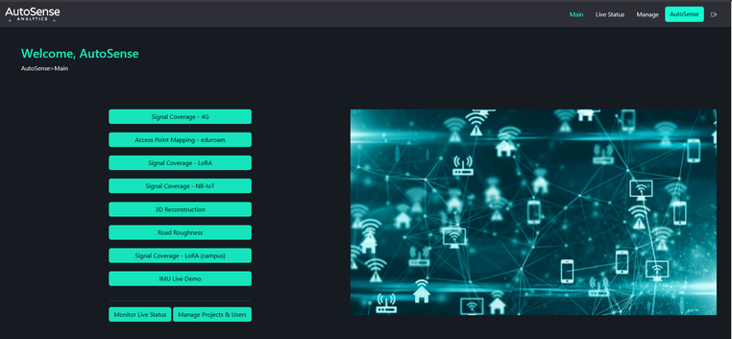



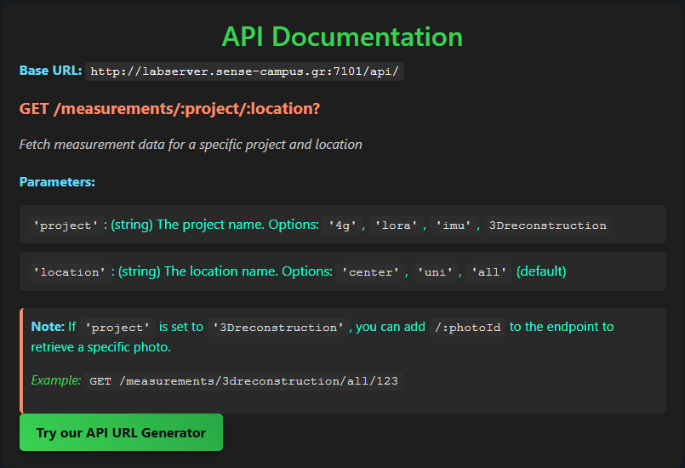




AUTOSENSE ANALYTICS
Deploy sensors on moving vehicles to collect real-time mobile data across various routes
Centralized Data Integration Platform offering unified and complete data presentation and analysis
(B2B Company Model)
On-demand data collection
Adaptation of IoT Technologies

Slide 4




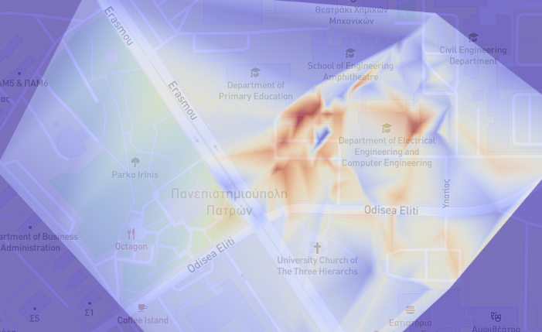
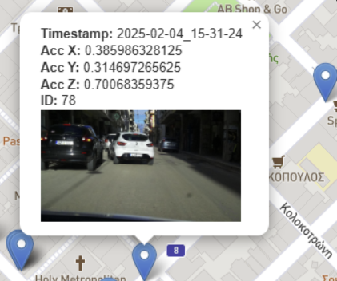
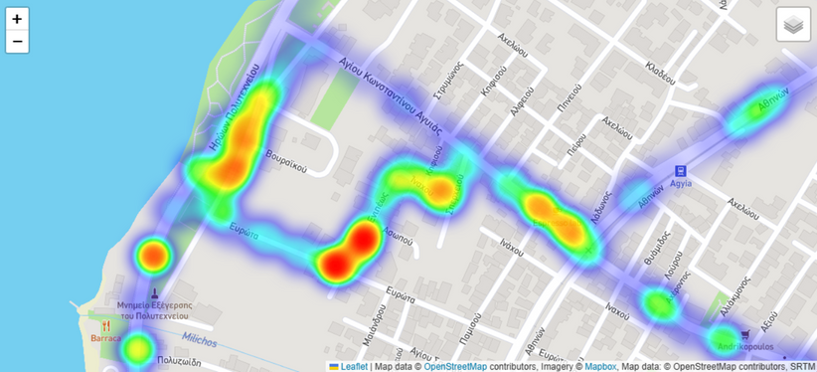

COMPLETED PROJECTS
Signal RSSI Mapping
Road Roughness
Image Collection
Measuring:
Detecting:
4G (4G hat for Rpi)
LoRa (Arduino)
WiFi
Collecting:
Road roughness detection using IMU connected to RPi
Images from RPi camera
IMU Measurements
GPS position
Providing:
Providing:
Providing:
Detection of dead signal spots
Creation of signal coverage heatmap
Creation of road roughness heatmap, pointing the potholes
Use photos for visual confirmation
Information from the images collected and confirmation of data analysis results

Slide 5
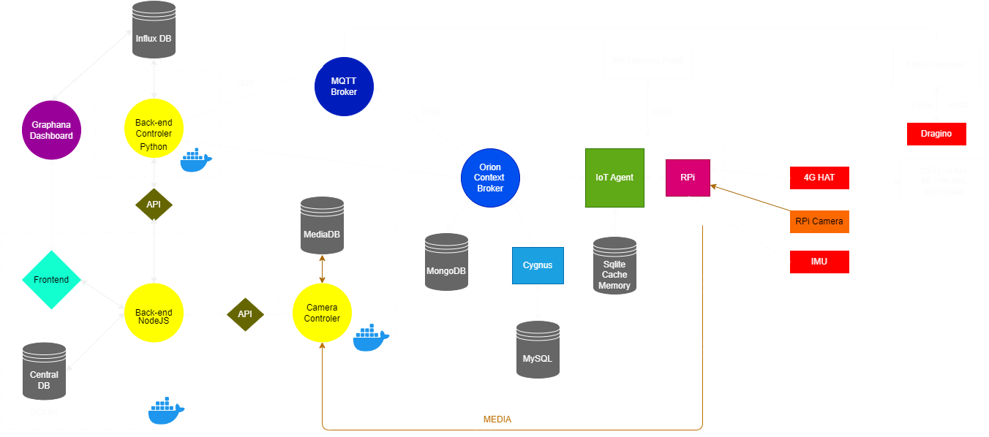
FINAL ARCHITECTURE OVERVIEW

Slide 6

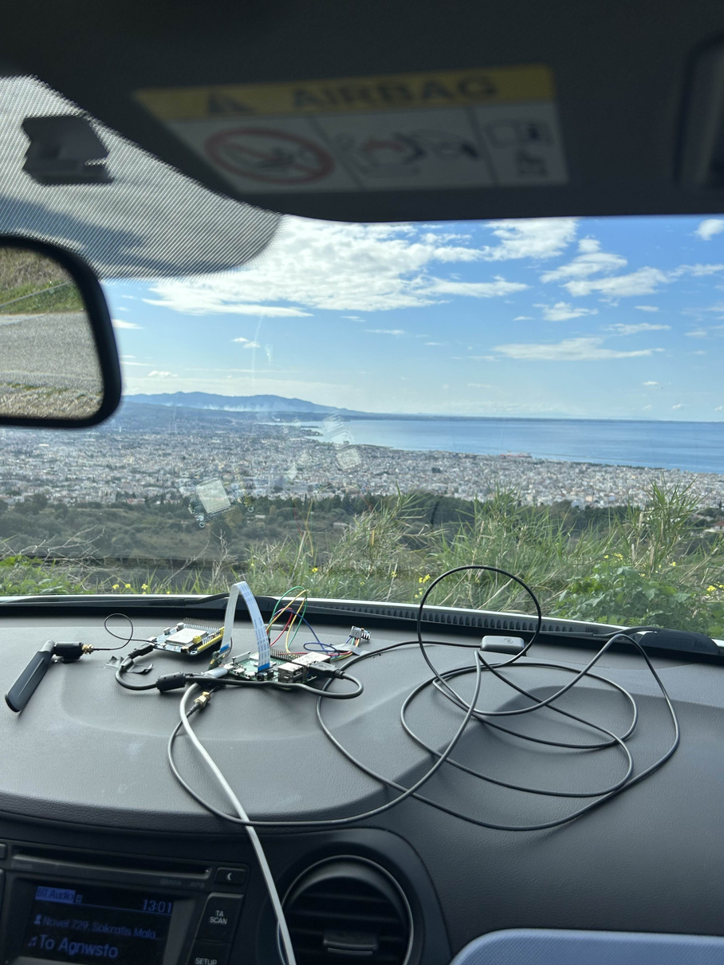
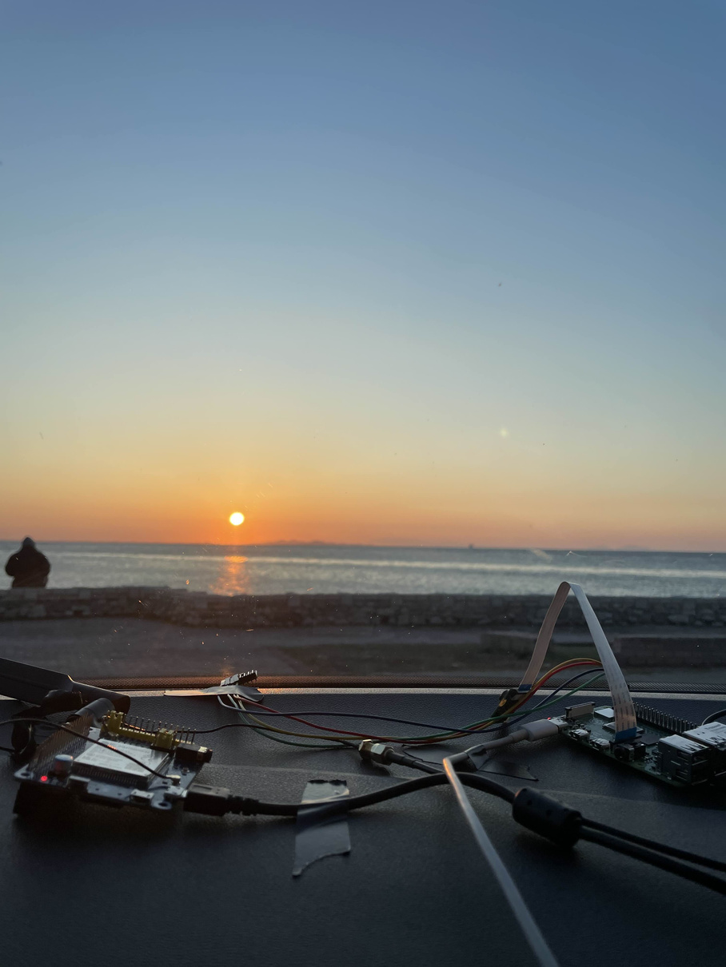
HARDWARE AND SENSORS

Slide 7
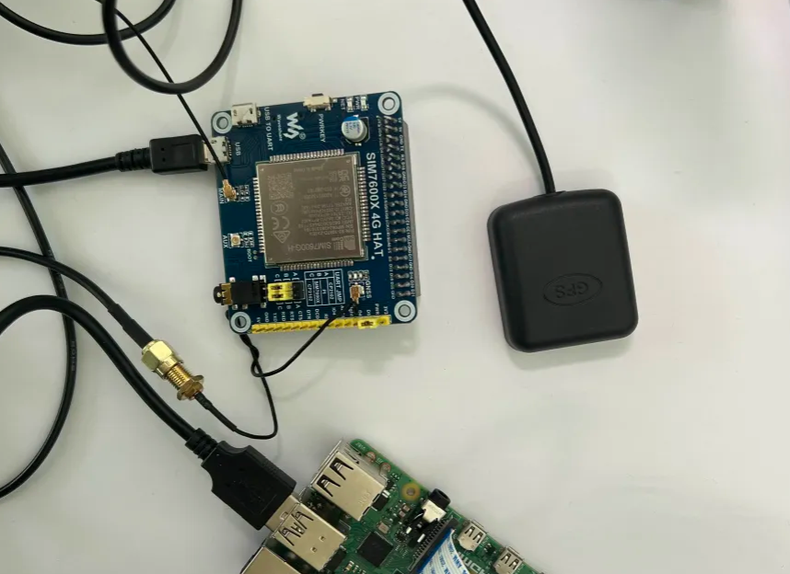
4G HAT
Hardware and Data Collection
Connected via USB port to Rpi
Retrives GPS and 4G RSSI values of NOVA Cellular Network (AT Commands) and posts it to FIWARE
GSM/4G LTE connection
Enter APN for NOVA and start the data session
Get the assigned IP address, gateway and DNS Servers
Configure the Rpi Network Interface (assign the IP and set the default gateway) in order to route internet traffic through wwan0.
Set Network Manager to manage the modem
Create a saved 4G Connection

Slide 8
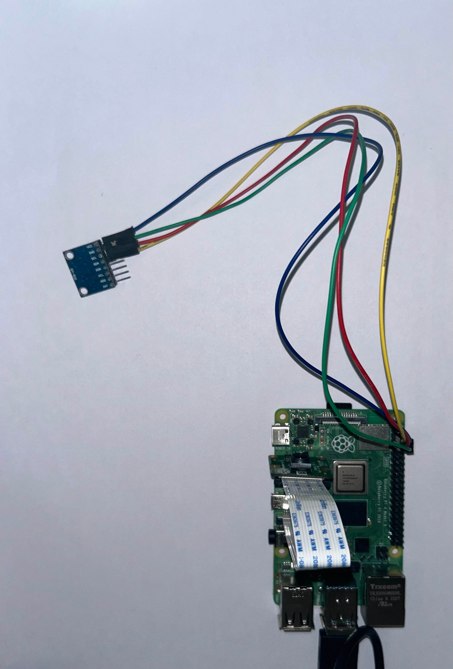
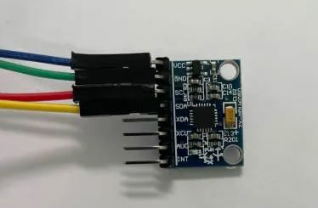
IMU SENSOR
Data Collecting
Measuring the acceleration at x ,y ,z axis at a 20Hz rate
Retrieving location, timestamp, speed, altitude from GPS Antenna every 2 seconds and posts it to FIWARE via 4G HAT, along with the accumulated acceleration measurements.
Data Processing
Keep only the z axis data, perform FFT for each window of 2 seconds (40 acc_z values)
Pass through Filter and keep only the >5 Hz frequencies
Calculate Roughness Score by summarizing the absolute values
Edge Processing can be implemented

Slide 9
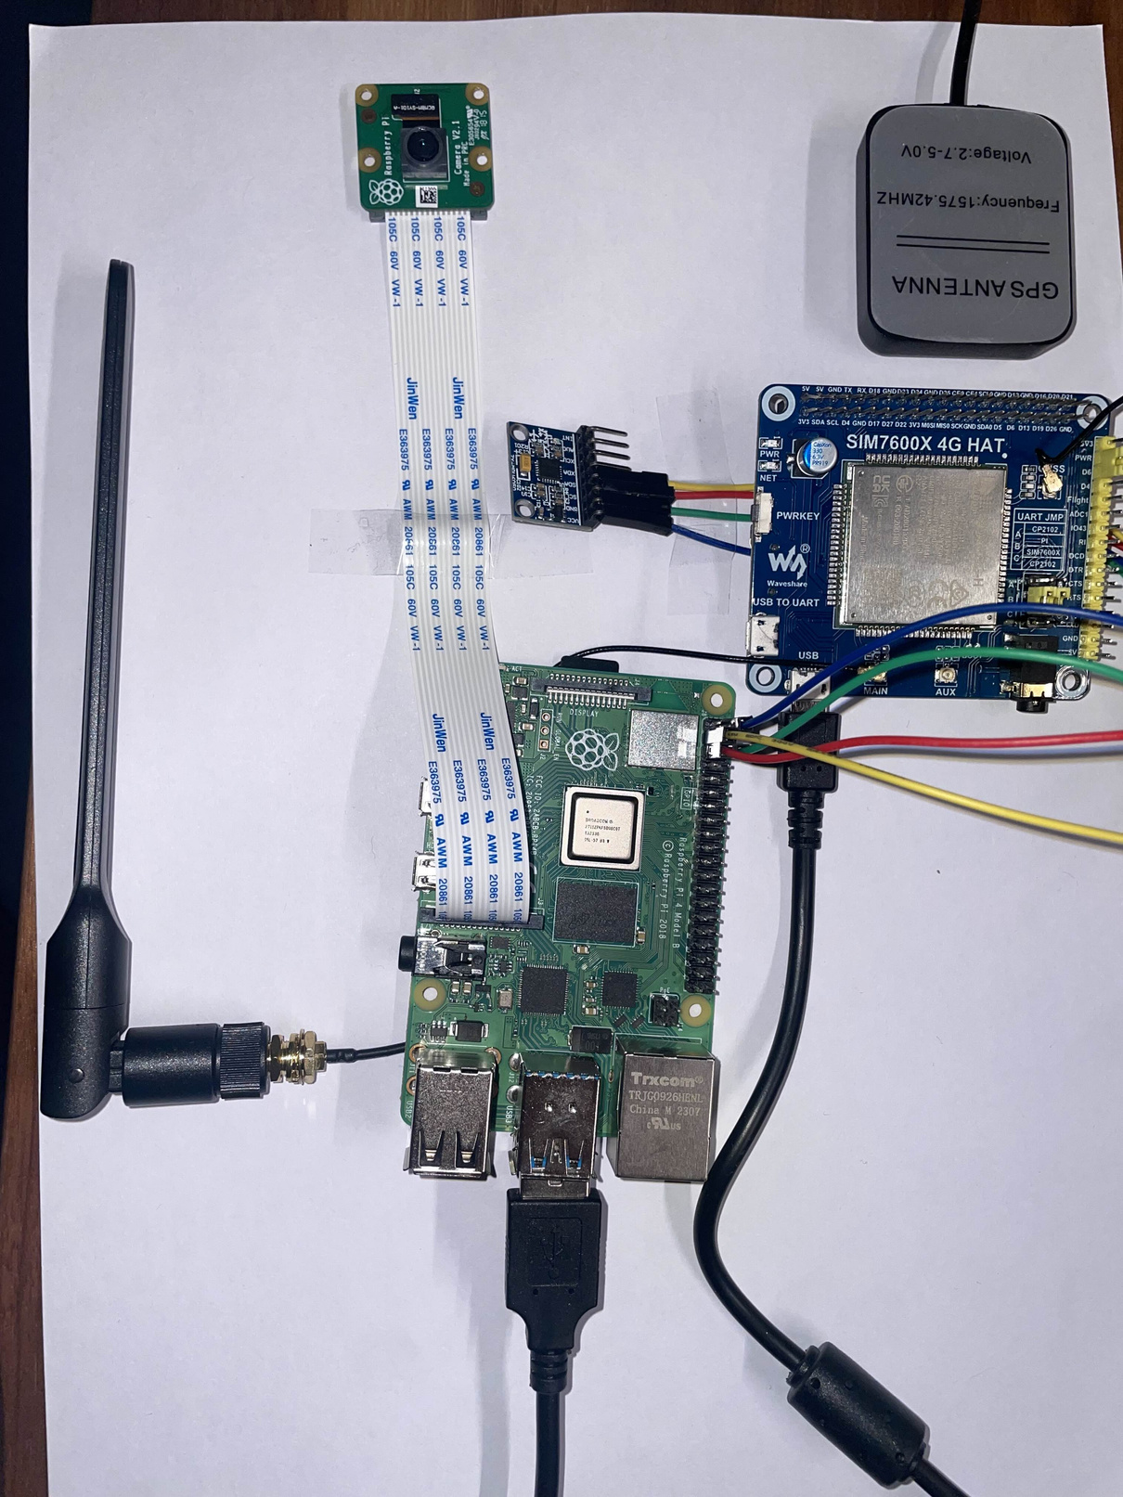
CAMERA
Hardware and Data Collection
Connected the camera via the Camera Serial Interface
The IMU on the GPIO pins
The 4G module, through USB
Implemented threads to capture an image, collect 3-axis acceleration (IMU), GPS position (4G module) and post (HTTP) those to the Camera Controller via 4G.
Camera Controller
Developed, containerize and hosted a Camera Controller
Receives the image, extracts the metadata, stores the image and its corresponding data
Provides an API, that offers access to the images

Slide 10
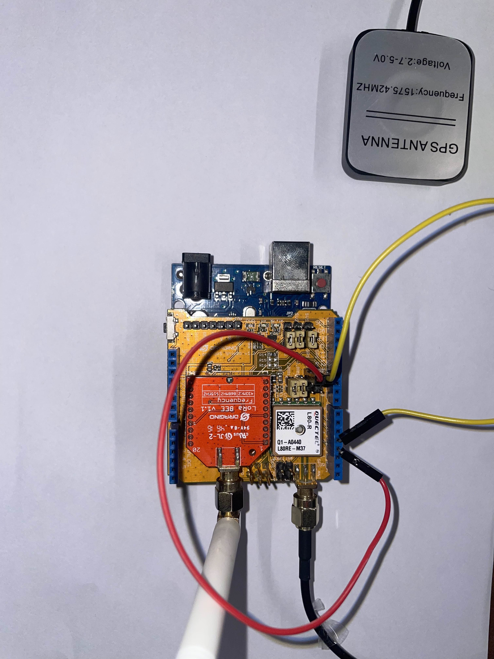
LORA
Using Arduino and Dragino for adding LoRaWAN connectivity
A LoRa packet is sent from Dragino containing its current GPS location
The LoRa antenna captures the LoRa signal and calculates the RSSI
An MQTT notification is being published, containing GPS, Timestamp, LoRa RSSI
Our backend controller has subscribed to the particular MQTT topic and posts the measurements to FIWARE
Utilized the work: https://github.com/Skorpinakos/LoRa-RSSI-Map

Slide 11
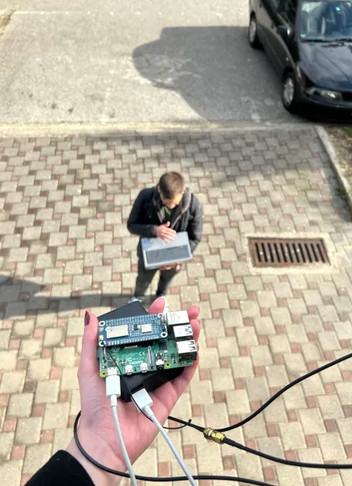
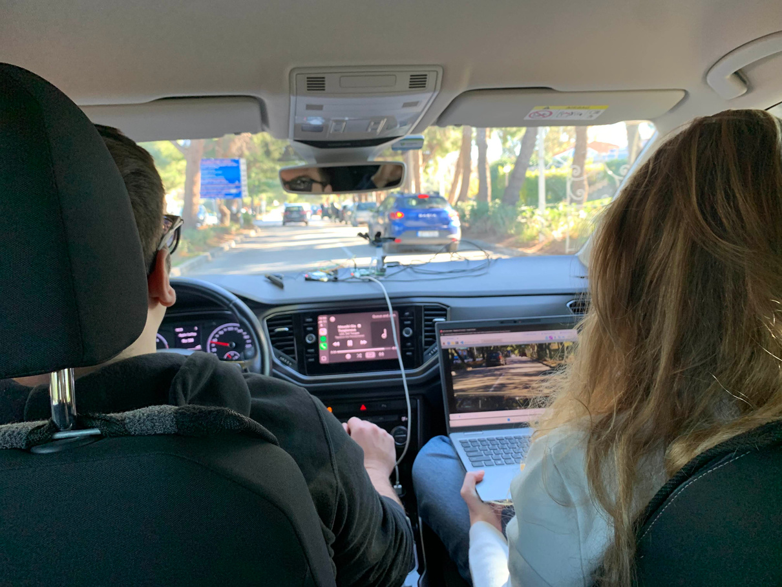
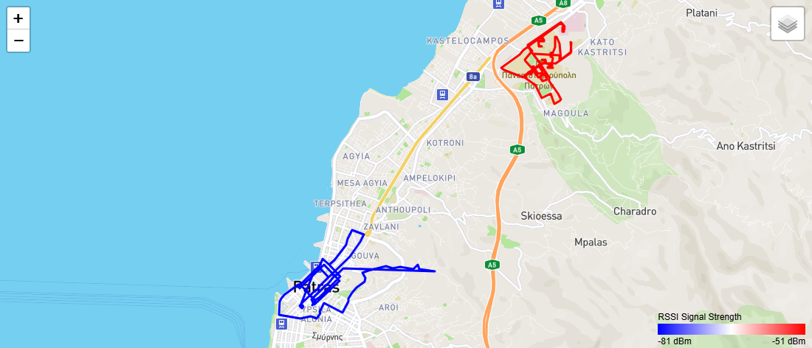
REAL DATA COLLECTION AT CAMPUS AND CITY CENTER

Slide 12
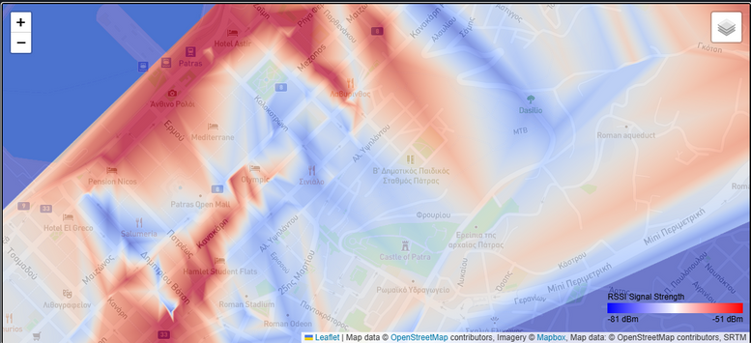
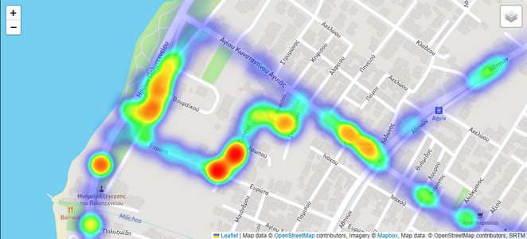
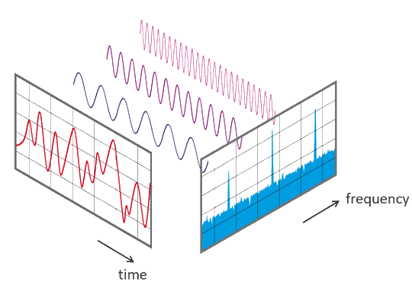
CHALLENGES
1
RSSI Heatmap Generation
2
IMU Data collection and processing
3
Combination of sensors (same interfaces)
4
Measurement interruptions due to shutdown or connection loss

Slide 13
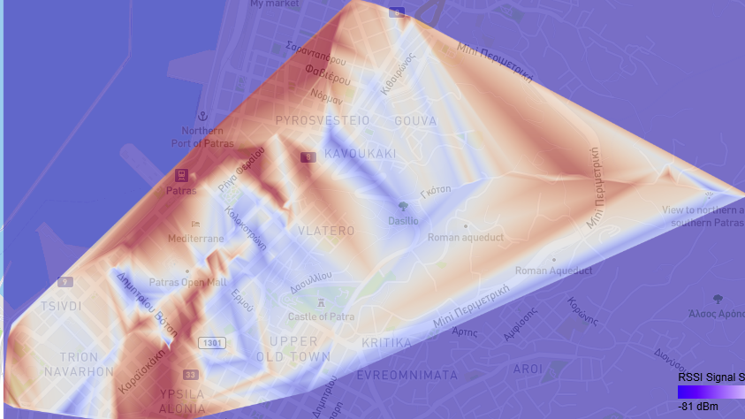

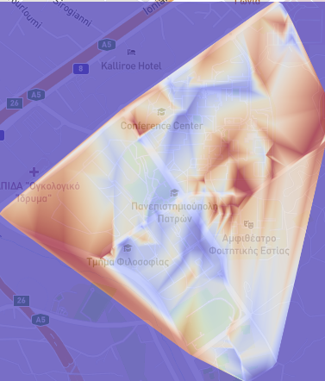

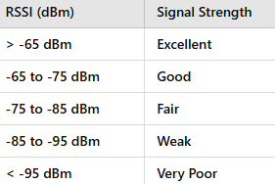
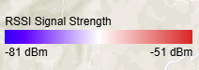
4G SIGNAL COVERAGE RESULTS
Using NOVA Cellular Network
Patras City Center
University Campus
Stronger 4G Signal at CEID (due to LOS)
Weaker Signal between buildings (near BA weak)
Stronger RSSI at open space areas
Weaker signal in the center due to buildings (shadowing, blocking)
Dasilio Patras, despite the location of the antennas, weaker signal due to height differences (possible no LOS)

Slide 14
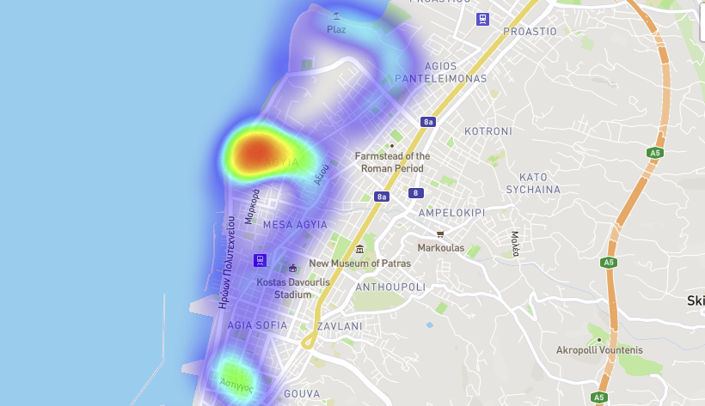
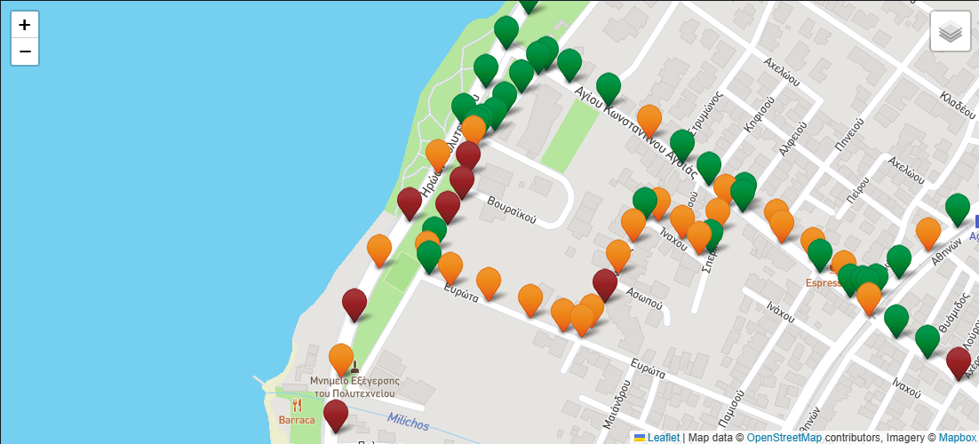
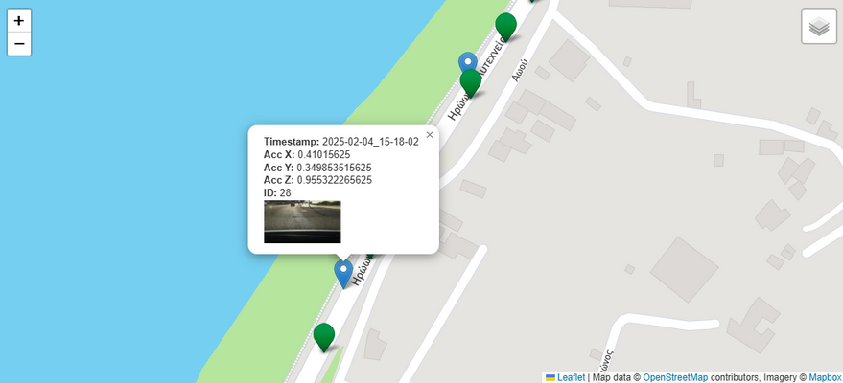
ROAD DATA RESULTS
Confirmed by photos taken by Rpi Camera Hat
Road Roughness Heatmap
Road Roughness Score Points
Image Confirmation at GPS locations

Slide 15
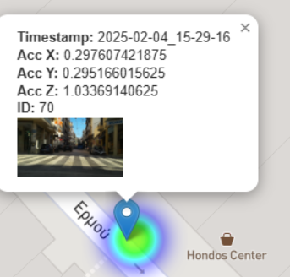
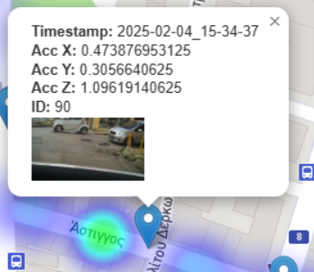
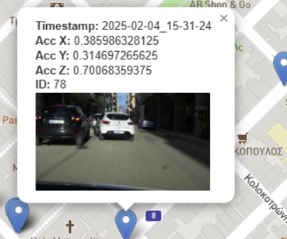
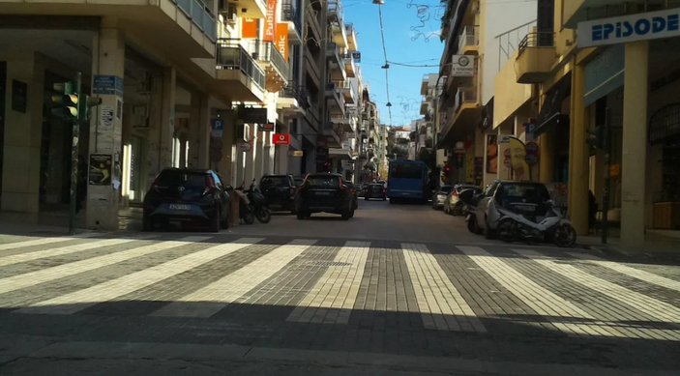
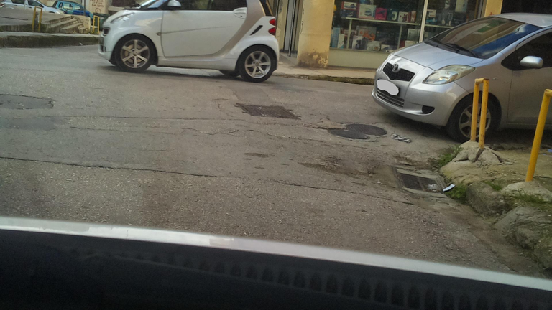
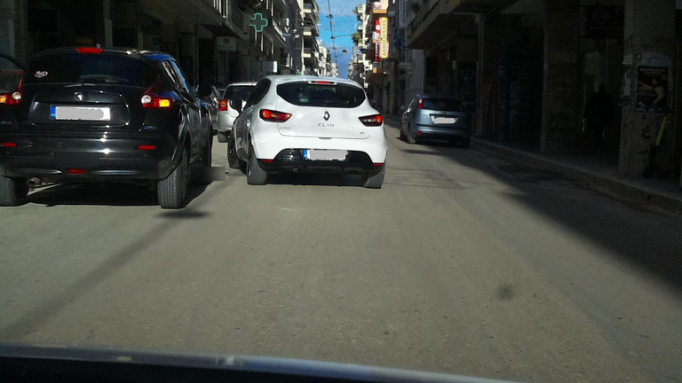
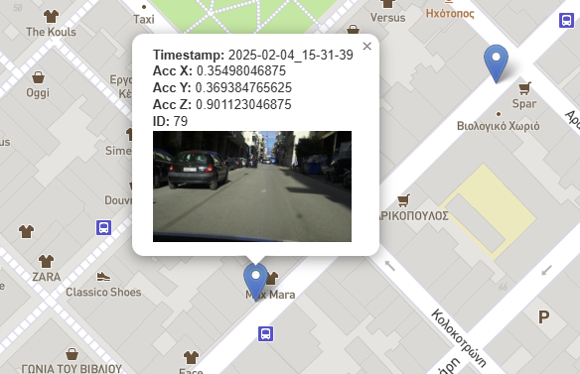
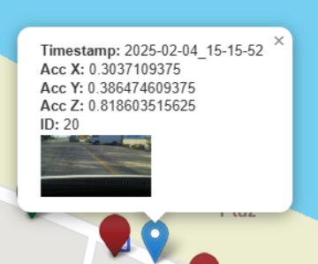
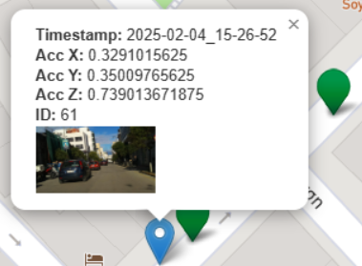
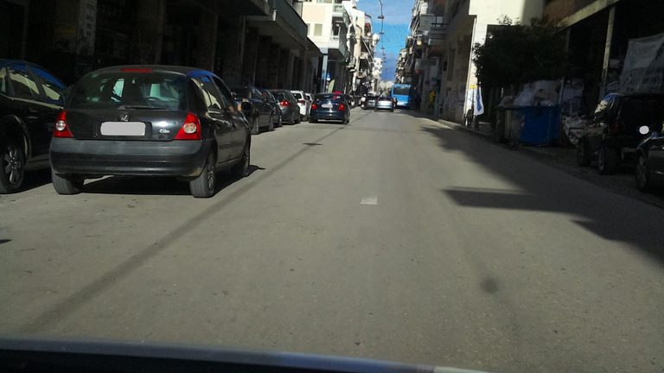
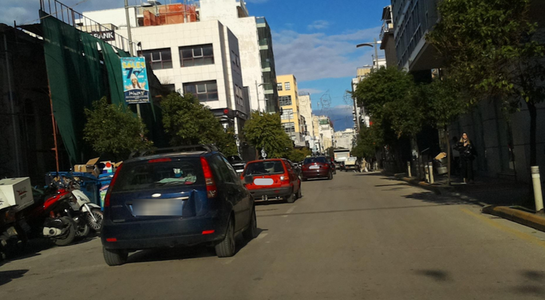
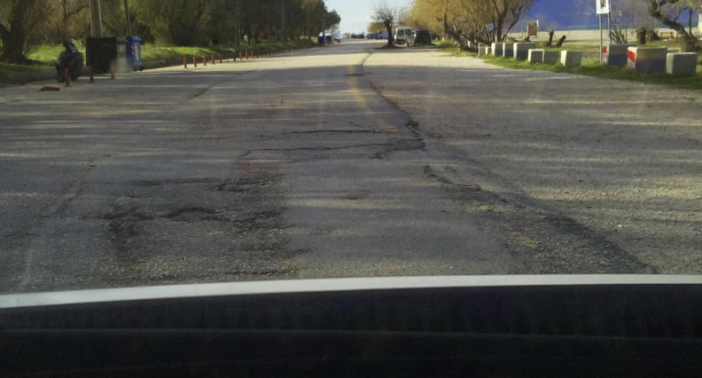
ROAD DATA RESULTS
Confirmed by photos taken by Rpi Camera Hat
Korinthou Road: Double-parked vehicles

Slide 16
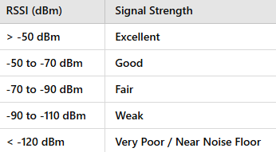
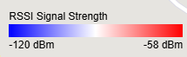
LORA SIGNAL COVERAGE RESULTS
Stronger LoRa Signal at ECE Parking (IoT Sensors)
Weaker Signal near Political Engineering Building

Slide 17
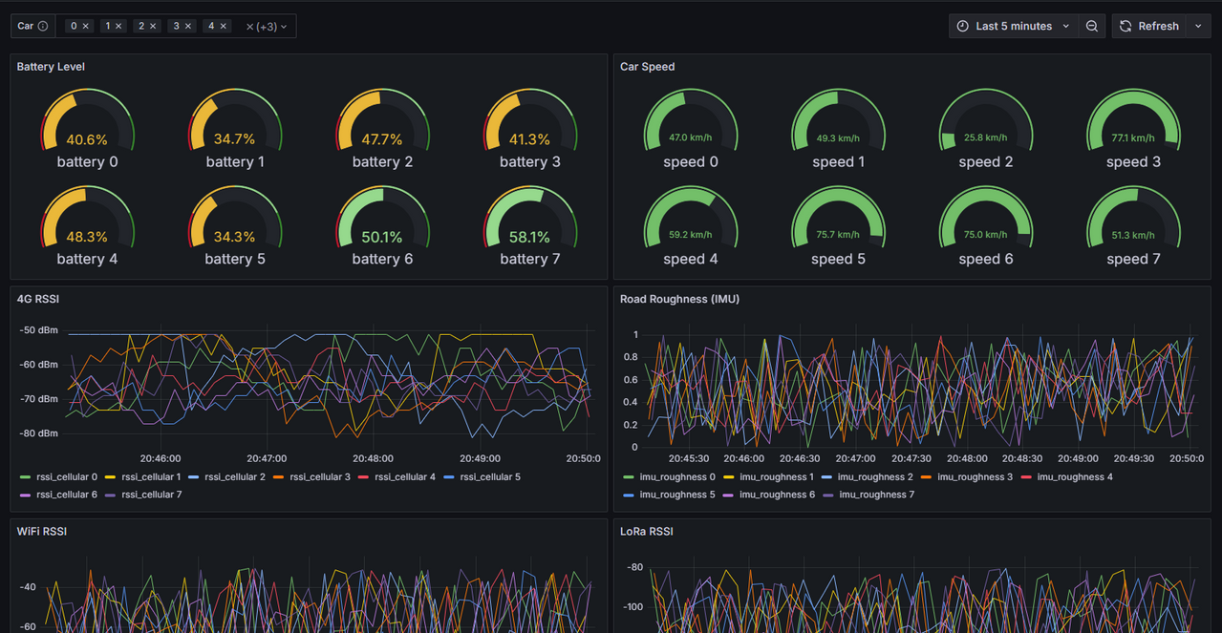
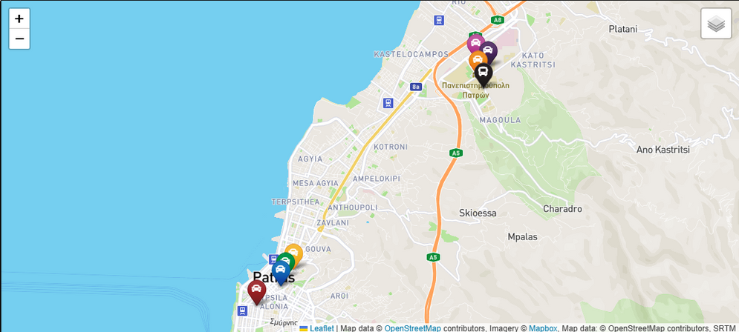
LIVE DEMO
1
2
Fake data generator, based on our real measurements
3
Parametric, customizable Dashboard and Live Map
Simulation of 7 cars

Slide 18
WEBSITE: STRUCTURE AND FEATURES
http://labserver.sense-campus.gr:7101/
1
Company Website (publicly accessed)
Info/Contact etc.
Login/Register
Admin Portal
Manage users and projects
Monitor Live Status
Access to all projects
2
Client Portal
Monitor the projects they are enrolled
Customizable Preferences (Light/Dark theme)
3
Dashboards and Heatmaps
Custom Dashboards and Heatmaps are embedded on the website page of the corresponding project
4
5
API
API implementation and documentation for each project
Easily accessible data (JSON Format)

Slide 19
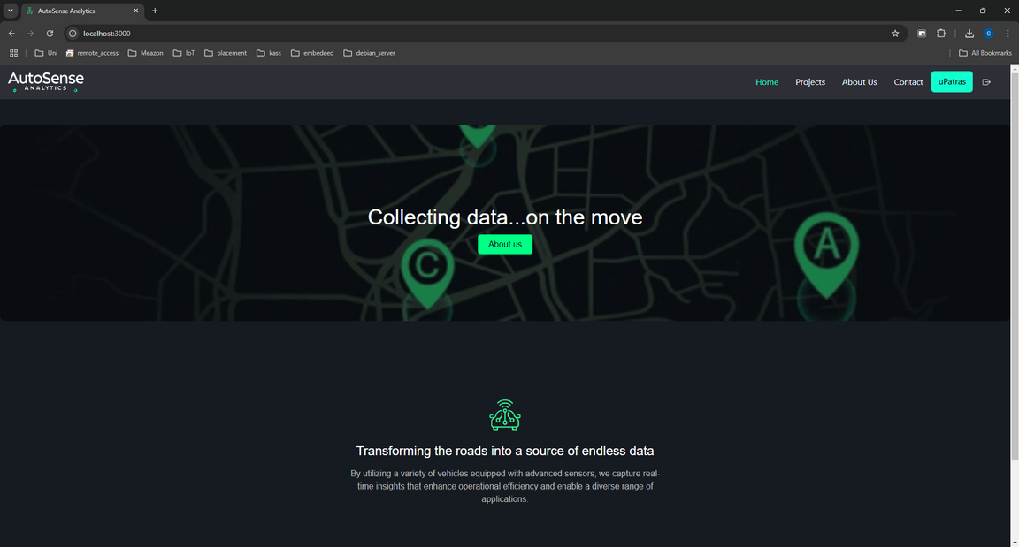
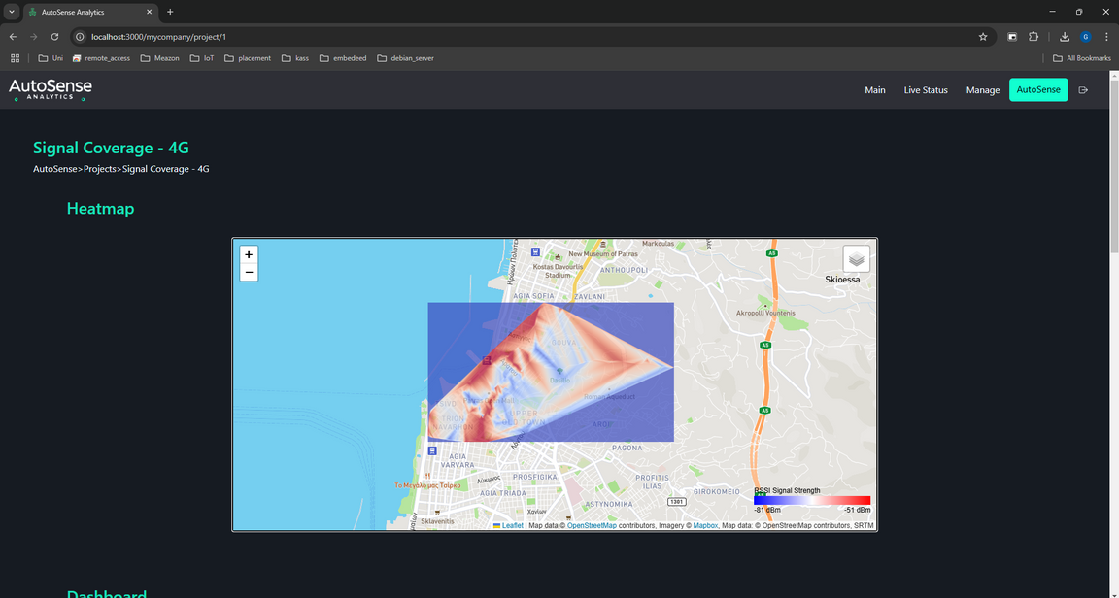
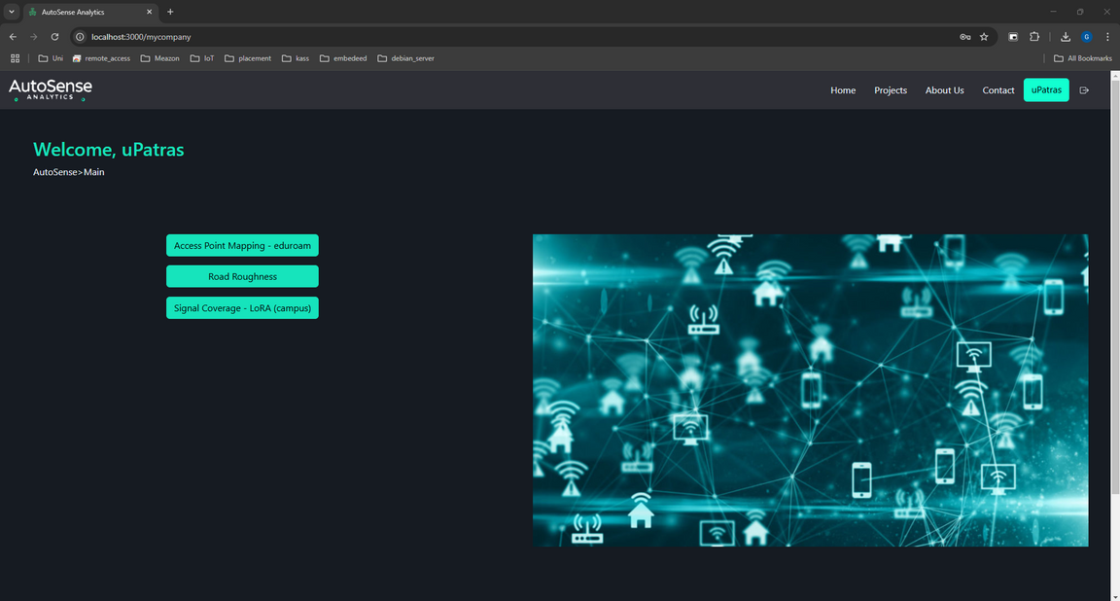

USER PAGES

Slide 20




ADMIN PAGES

Slide 21


API

Slide 22





LIVE DEMO
IMU
ACC
Lab Server: 1026
Our Website
Backend Controller
(Hosted on Lab Server)
Lab Server: 7101
Lab Server: 3306
Lab Server:8086
Lab Server:8087

Slide 23



TASK DISTRIBUTION
Local Data Base Storage on RPi
Back-end controller syncing data between InfluxDB and FIWARE’s MySQL DB
FIWARE notifications to Back-end Controller
Camera Controller
Data analysis and representation (e.g. heatmaps)
Grafana Dashboards and InfluxDB
Live Demo using Real Data
Web Development: Front-End, Back-End
IoT Agent and FIWARE communication
Retrieving GPS coordinates from modules and combine them with RSSI values
LoRa, Camera, WiFi configuration
IMU and edge processing using fft, bandpass filters
4G measurements and utilization of hat as a modem
Combination of sensors and communication using Threads
Containerization of Website, Controllers and host them on lab server using Docker
Real Time Measurements

Slide 24






OUR PROJECT AVAILABLE ON
GitHub
(Source Code)
YouTube (Video Demo)
Website

Slide 25





OUR TEAM
Eleni Sakellariou Matsi
Georgios
Stergiopoulos
Student @ ECE Upatras
Student @ ECE Upatras
Specialization
Communications
Specialization
Computer Engineering
+30 6987095462
+30 6931152410
up1084047@ac.upatras.gr
gstergiopoulos@ac.upatras.gr

Slide 26


AutoSense
Analytics
Thank's For Watching
Connect with us.
+30-2610-995-386
contact@autosense.com

